Slide 1
Problems of Constitution-Making in Pakistan

Slide 2
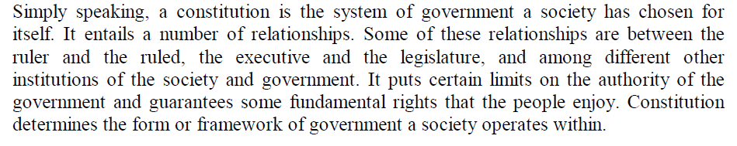
Definition of a Constitution:

Slide 3
Professor K.C Wheare defines the constitution as:- “ The whole system of government of the country the collection of the rules that establish and regulate or govern the government. The constitution can also be defined as a document which contains the rules regarding framework of the government”

Slide 4
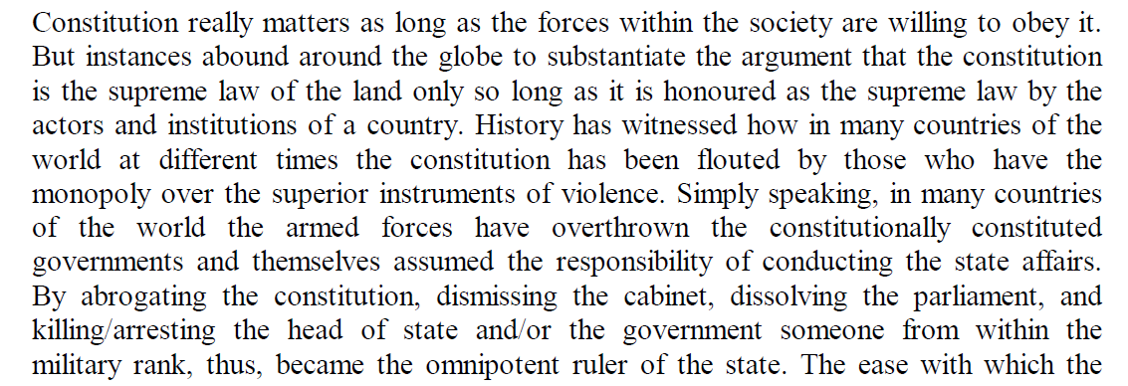
Does Constitution really matter?

Slide 5
Pakistan, which won its independence in 1947, is confronted with the task of framing a constitution. A Constituent Assembly was set up for this purpose under the India Independence Act of 1947. The task, however, proved to be highly complex and threatened to be a major national problem endangering national unity.

Slide 6
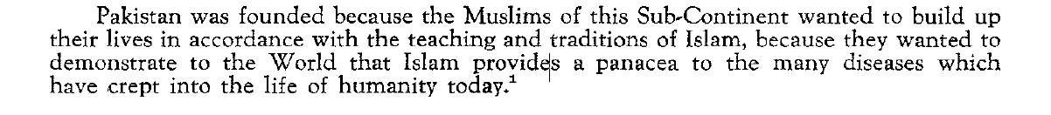
The first and most difficult problem was the exact character that the state should take.
The vast majority of the people of Pakistan are Muslims. Their aspiration to preserve and foster Islamic values was the main justification for insisting upon the partition of India. It may be said that implicit in the demand for an independent Pakistan was the demand for an Islamic state. Some speeches of important leaders who were striving for Pakistan lend themselves to this interpretation. The first prime minister, Liaquat Ali Khan, in introducing the objective resolution of the Constitution of Pakistan in the Constituent Assembly stated:

Slide 7
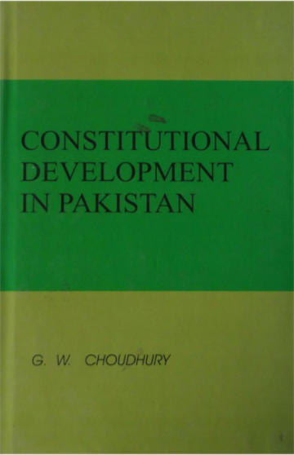
In his widely acclaimed book, entitled, Constitutional Development in Pakistan, Professor G. W. Choudhury observed that:
“Pakistan has become a laboratory for constitutional experiments”( 1959, page 1).

Slide 8
Problems of constitution-making in Pakistan, 1947-56
Geographical absurdity
State language debate
Question over the forms of government
Political instability
The place of Islam in politics
Regional economic disparity
Executive supremacy
Leadership crisis
Absence of a nationwide political party
Internal colonialism & a “Double Country”
Absence of democracy
Palace intrigue
Kashmir conflicts
Civil-military bureaucratic dominance in politics

Slide 9
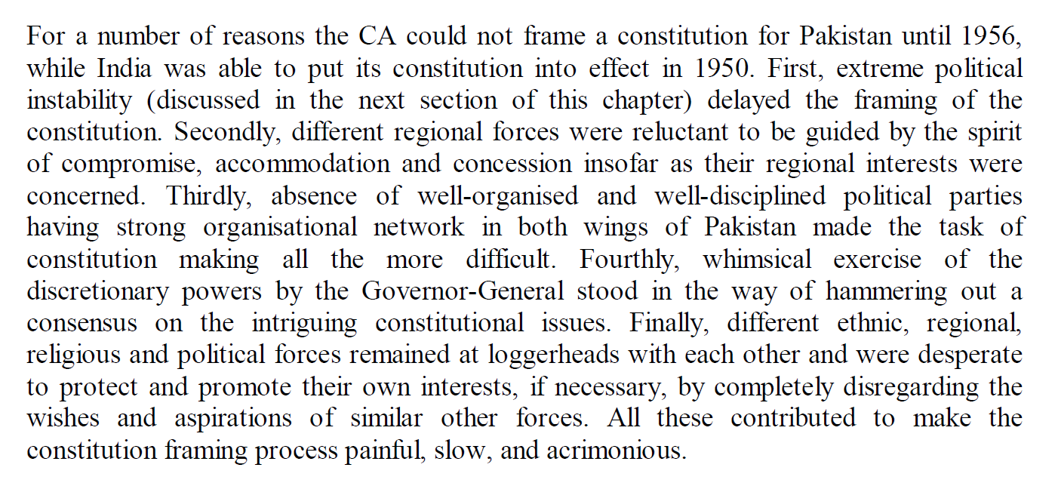

Slide 10
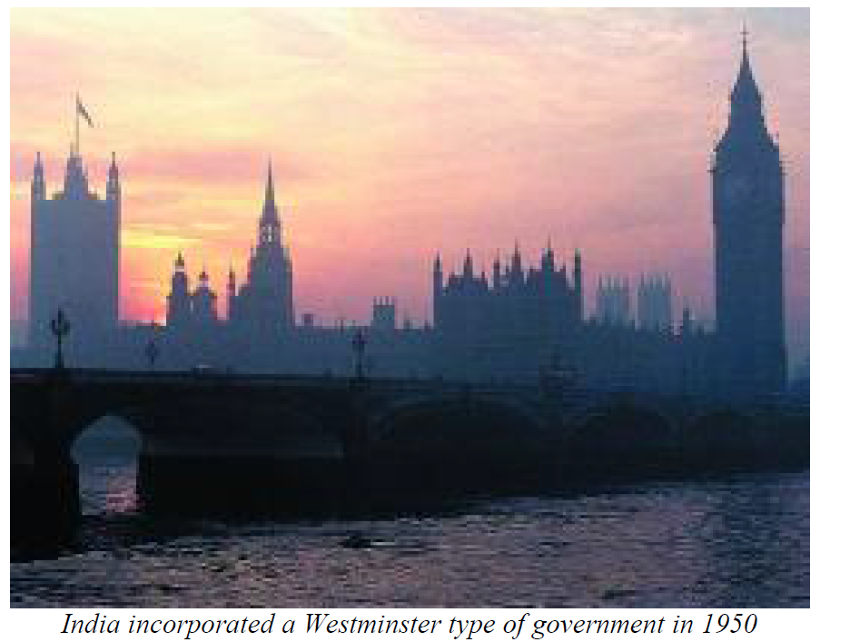

Slide 11
The most fundamental question that has challenged the constitution-makers and other political leaders in Pakistan was “how to keep the two physically and culturally separated regions of the country linked together as one nation and one state” ( K. B. Sayeed, The Political System of Pakistan, Oxford, 1967, p. 208).

Slide 12
One of the main obstacles in the constitution-making was the peculiar geographical position of Pakistan. The two wings of Pakistan do not have any common bond except the sentiment of religion. Western and Eastern Pakistan distance was about 1000 miles/ 1200 Kilometers. As a result, this geographical separation made the communication between the two wings difficult and expensive.

Slide 13
The controversy between East and West Pakistan was closely related to the question of state language ( M. Rashiduzzaman, Pakistan: A Study of Government and Politics, Dacca: Ideal Library, 1967, p.92).
From the beginning Pakistani rulers were concerned about the geographical separation of the country by hostile India and perceived the dominance of Bengali language in East Bengal as the number one barrier towards achieving political integration.
A lasting institutional imbalance within the Pakistani state structure.

Slide 14
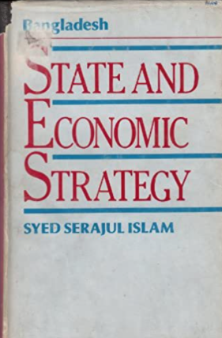
The influence of Islam: The most unique feature of Pakistan was that the new state was born on the basis of religion. Pakistan was founded on a political commitment that it would be governed according to the guidelines of Islam. In Islam, there has never been a distinct between the civil and military authorities since Islam doesn’t divide the Ummah (community) into civil and military entities (Syed Serajul Islam, Bangladesh: State and Economic Strategy, Dhaka: UPL, 1988, page. 24). Thus, the constitution makers had to face the theocratic issues of Islam as a source of legitimacy and integrity of the state.

Slide 15
As long as Jinnah was alive (he died September,1948),he was Pakistan. He held the position of Governor-General, but the powers and influence that he exercised were far beyond those normally associated with that office (K.B.Sayeed, The Political System of Pakistan, 1967, page 62).

Slide 16
Both Muhammad Ali Jinnah and Liaquat Ali Khan relied very heavily on the civil servants. The rise of civil-military bureaucracy was a major factor affecting the rule of the United Pakistan.

Slide 17
After death of Jinnah, regionalism, factionalism and opportunism became the general rules of political system of Pakistan. Quite contrary to Congress in India, Muslim League failed miserably to transform itself into a national political party from nationalist party.

Slide 18
Between August 1947 and October 1958, there were as many as seven cabinets, the average life of a cabinet being nineteenth months only.

Slide 19
At the time of inception of Pakistan, Pakistan faced security threats from India and Afghanistan, therefore, to meet the Indian or Afghanistan aggression, a strong and efficient military was pertinent. It became evident that defense would be the primary concern and Pakistan military would have to play active role in matters related to defense. Kashmir was a constant source of military conflict and war between Pakistan and India (For a brief review, please see my review article , https://doi.org/10.18357/bigr11201919275).

Slide 20
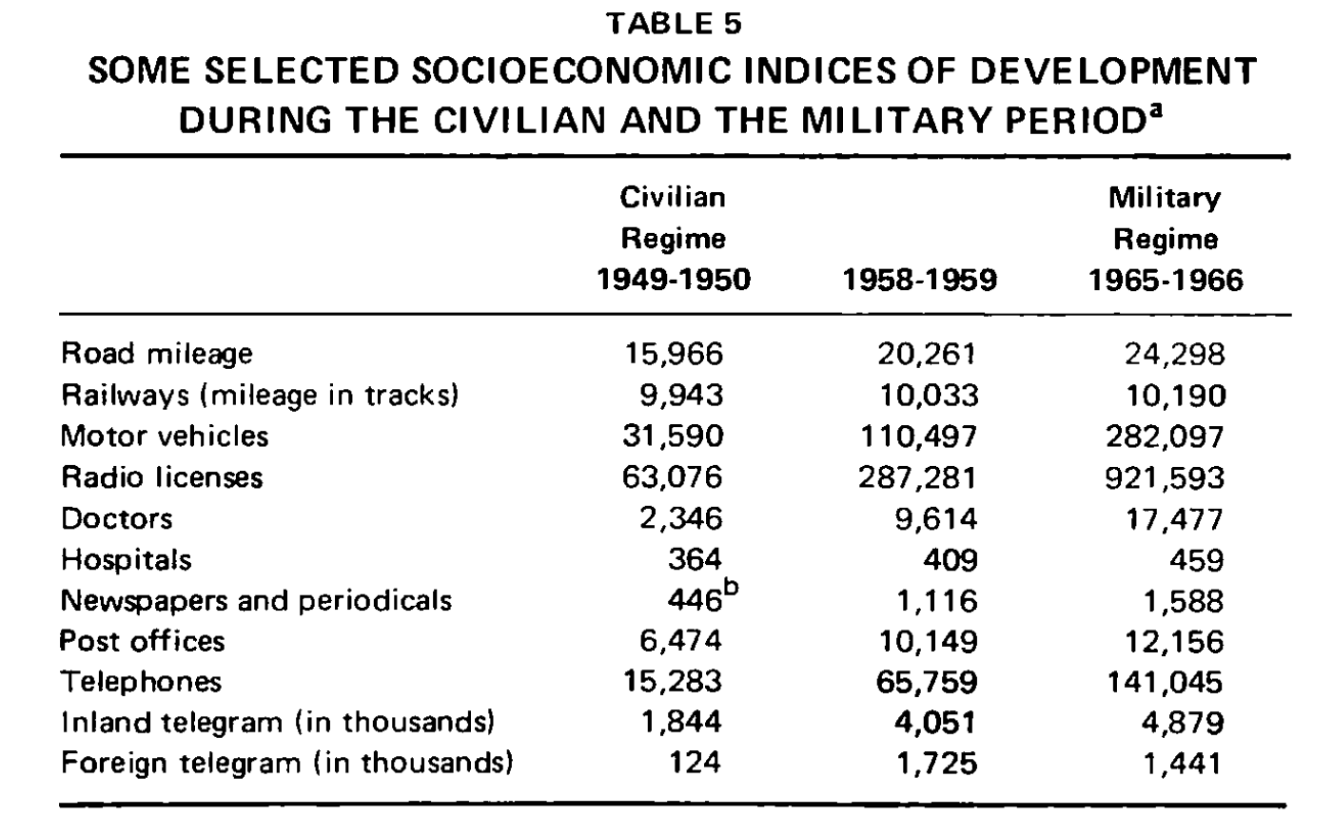
Inequality between East and West Pakistan:

Slide 21
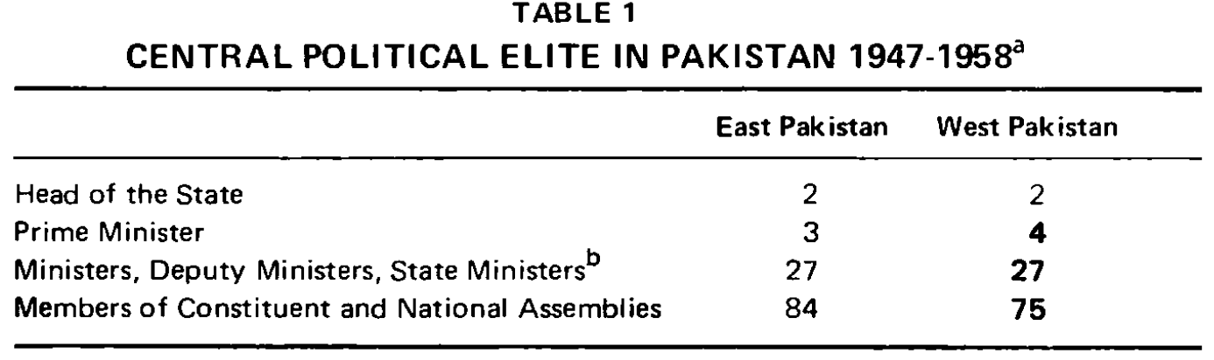

Slide 22
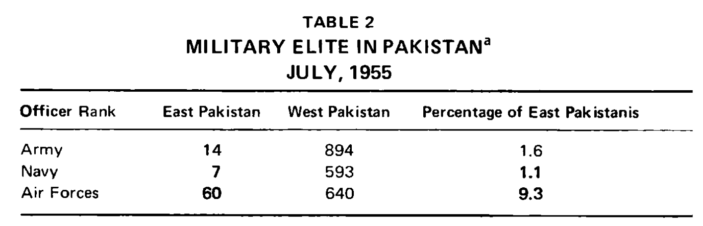

Slide 23
Not only is the Pakistani military recruited from a few selected regions, it also does not represent the new middle class referred to by Halpern. In the British Indian Army, training in England was required for commissioned ranks. This facilitated recruitment of military officers from wealthy families who could afford to bear the expenses of foreign training. And since most of the wealthy Muslims of the Punjab and Northwest Frontier Province were landlords, the military officers often came from landed aristocracy ( Rounaq Jahan, “Ten Years of Ayub Khan and the Problem of National Integration”, Administration & Society 1970 2: 277)

Slide 24
Conclusions and Questions

Slide 25
REFERENCES:
G. W. Choudhury, Constitutional Development in Pakistan
K.B. Sayeed, The Political System of Pakistan
Rounaq Jahan, Pakistan: Failure in National Integration
Syed Serajul Islam, Bangladesh: State and Economic Strategy
Antía Mato Bouzas, Kashmir as a Borderland: The Politics of Space and Belonging across the Line of Control

